Slide 1
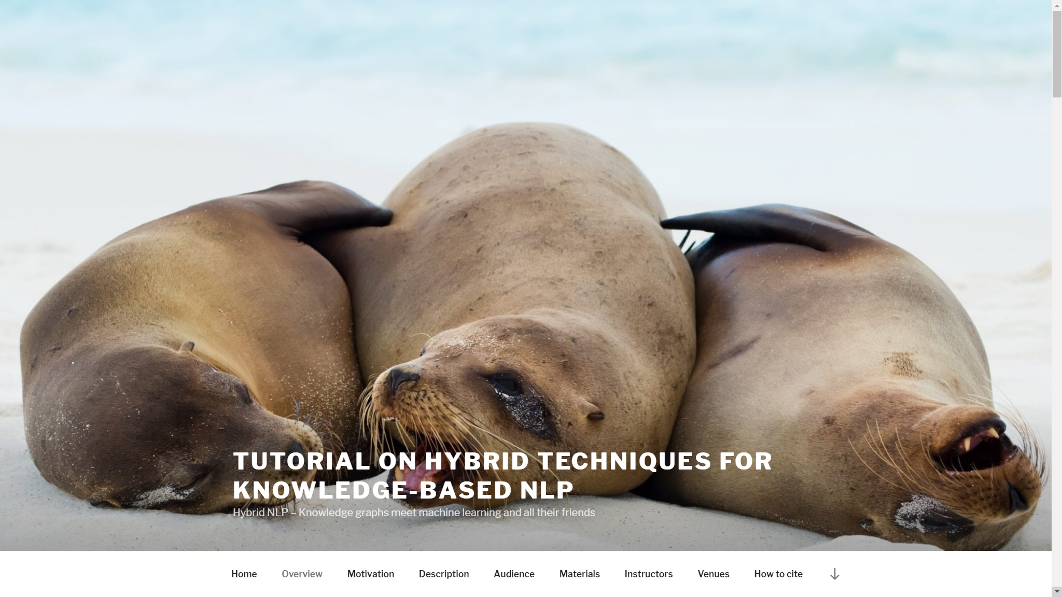
http://hybridnlp.expertsystemlab.com/tutorial

Slide 2
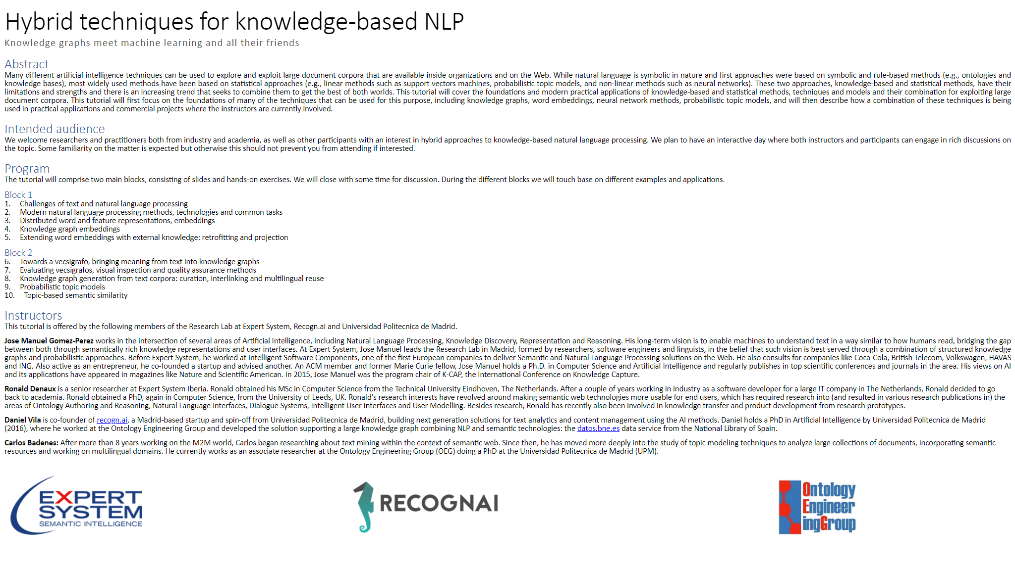

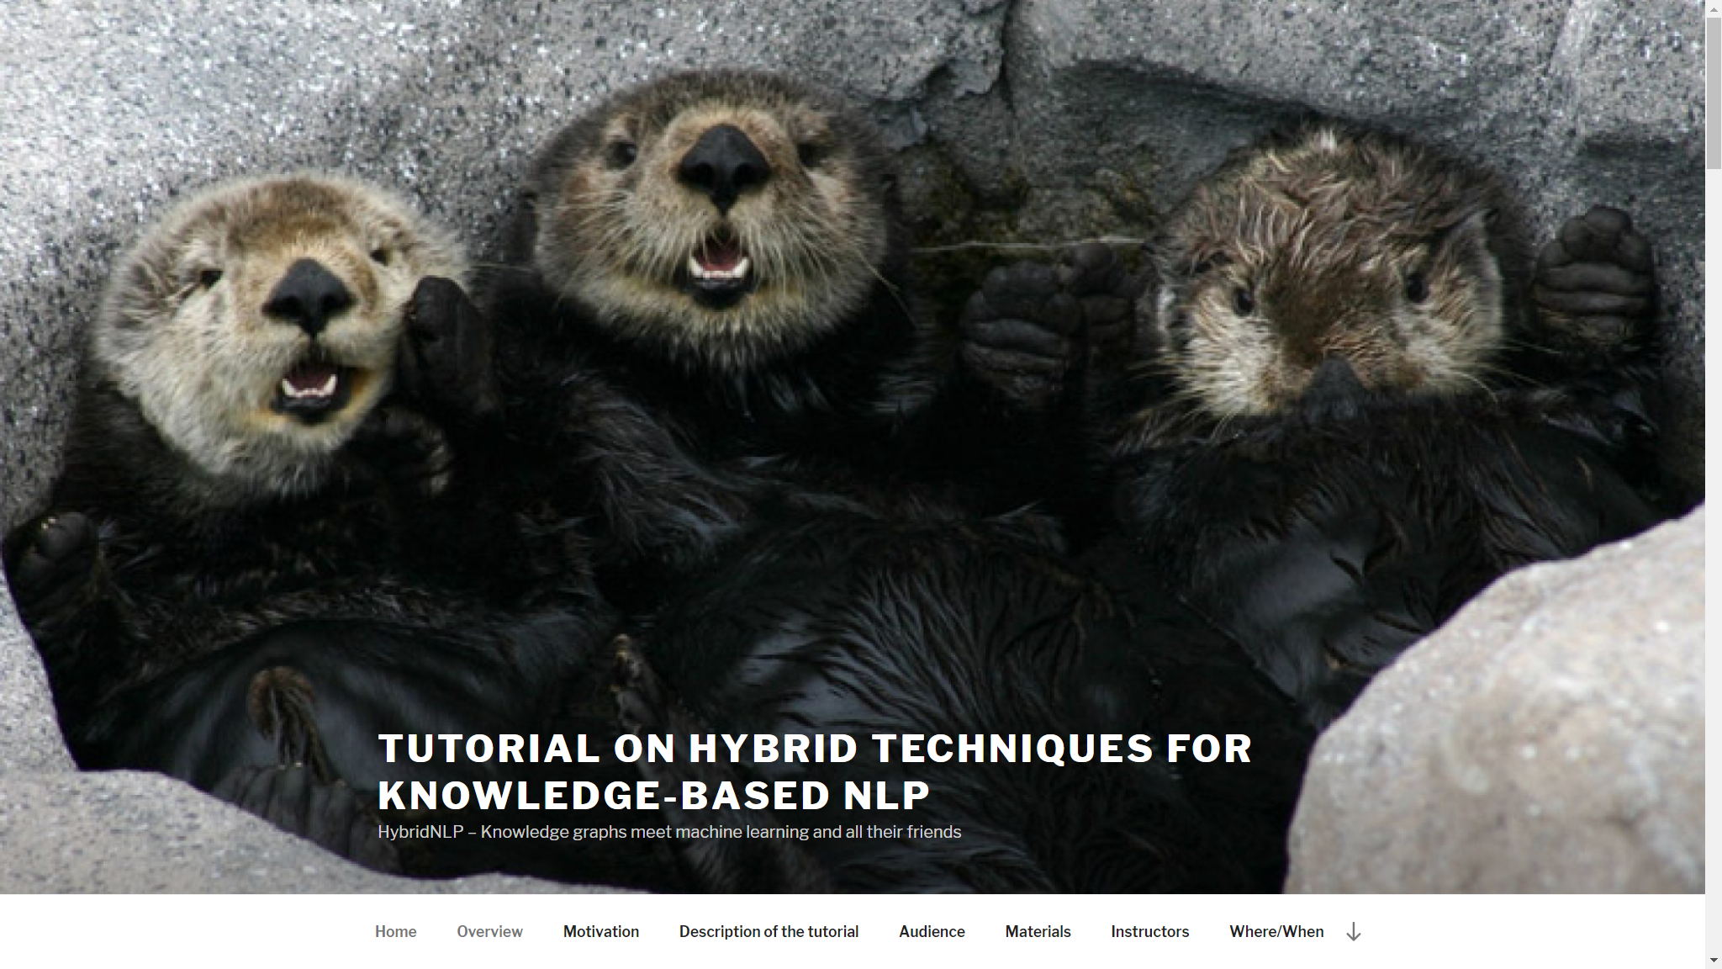


3rd edition of the Hybrid NLP tutorial

Slide 3

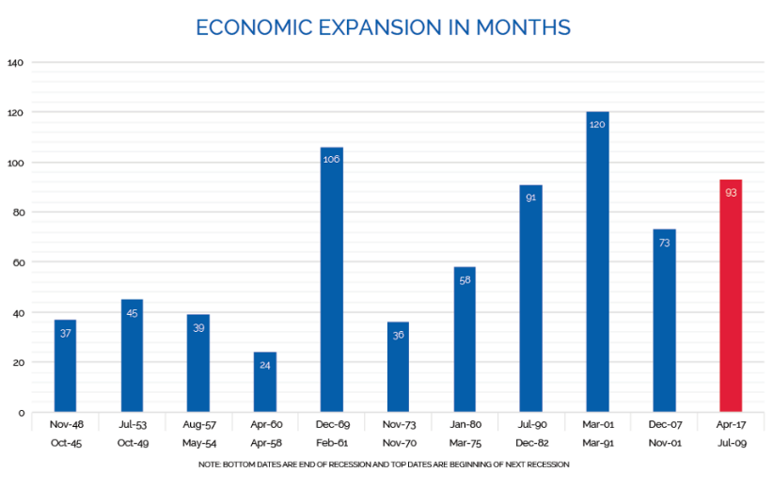
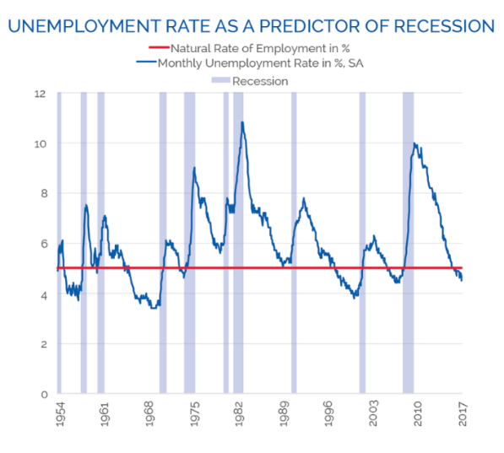
How do we humans reason?
Is Another Recession Coming?
[..] the length of the current recovery – 93 months as of April 2017 – is the third longest of the 11 expansion periods since the end of World War II. Should the recovery last past May 2018, it would surpass the 106-month expansion of 1961-1969. It would match the longest period, 120 months, in July 2019. Looking simply at the cycle, one could say the due date is near.
[..] when the unemployment rate falls below 5% [..] a recession usually follows within the next two or three years. For example, the unemployment rate started sinking below 5% in December 2005, and the Great Recession started in January 2008 — 25 months later.
Notes:
https://www.forbes.com/sites/axiometrics/2017/04/21/is-a-recession-coming/#2ea508ad6103

Slide 4
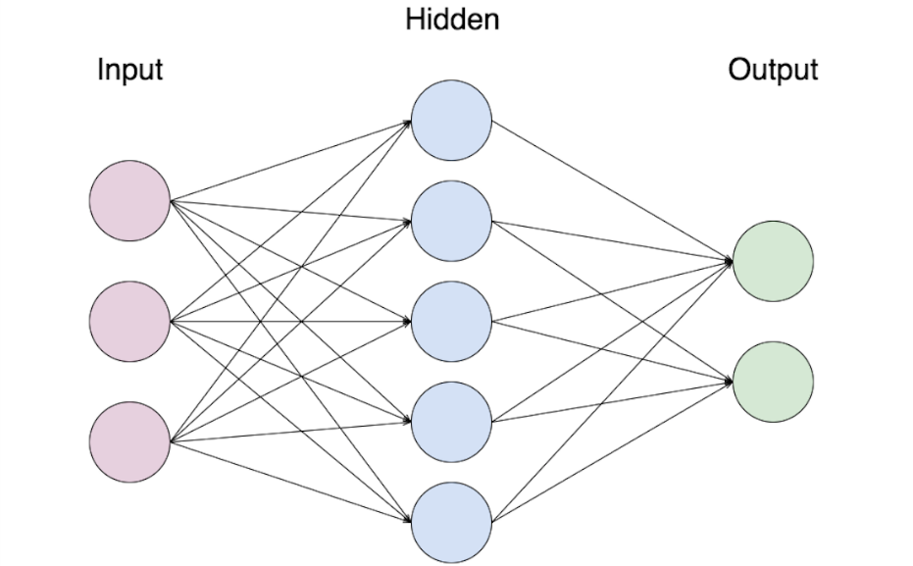
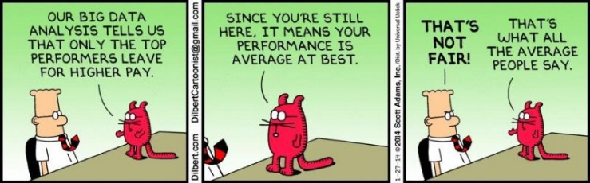
The data-driven approach
Is Another Recession Coming?
Big Data
Unemployment
yes
Economic expansion
no
Housing market
GPUs
Prediction
Recession
Powerful and cheap if quality data abounds
Models can be biased, depending on the dataset
Statistic induction, not (logically) explainable
However, humans seek meaning and causal explanation

Slide 5

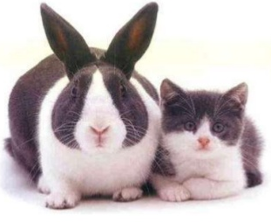

But, how important can reproducibility and justification be?
47 of 53 landmark publications in cancer research could not be replicated
Notes:
In addition to finance I’m wroking in other domain where logical justification and explanation are actually key. Explanation is indeed important, amongst other things for reproducibility in scientific research. How to achieve it? For example, encapsulating scientific investigations in objects which contain all the necessary knowledge to automatically reproduce scientific claims

Slide 6
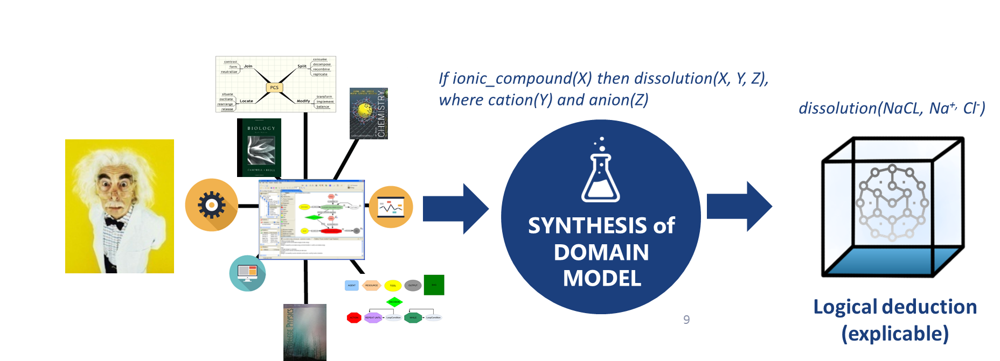


The knowledge-based approach
PROS
CONS
Detailed, expressive models based on human rich understanding of the domain
Tools can enable user-entered knowledge and optimize cost
The underlying logical formalism supports logical explanations
Individual knowledge types considered
Requires a considerable amount of well trained, centralized labor to manually encode knowledge
Lacks scalability with large corpora and costly due to humans in the loop
Possibly brittle, hard to generalize
Prone to human and expert bias
Notes:
What we learnt from knowledge-based approaches like Halo

Slide 7
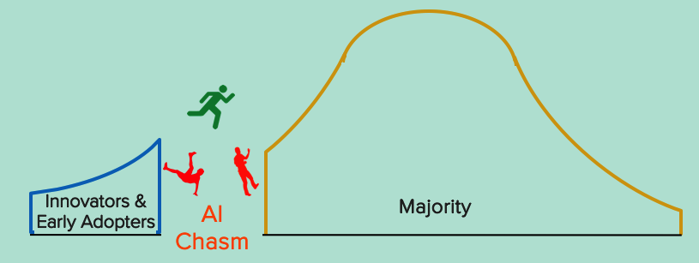
The AI Chasm
How can we merge human and machine understanding?
Is this possible or are they cognitively disconnected?
If it is, what mechanisms are needed to cross the cognitive chasm?
Towards fully-fledged cognitive computing
And, how should knowledge be represented in ways that are flexible, scalable, deep and logical?
Notes:
Recap the previous slides (statistical vs KB) and go the point on the cognitive chasm
Machine Understanding vs. Human Understanding
Towards fully-fledged cognitive computing

Slide 8
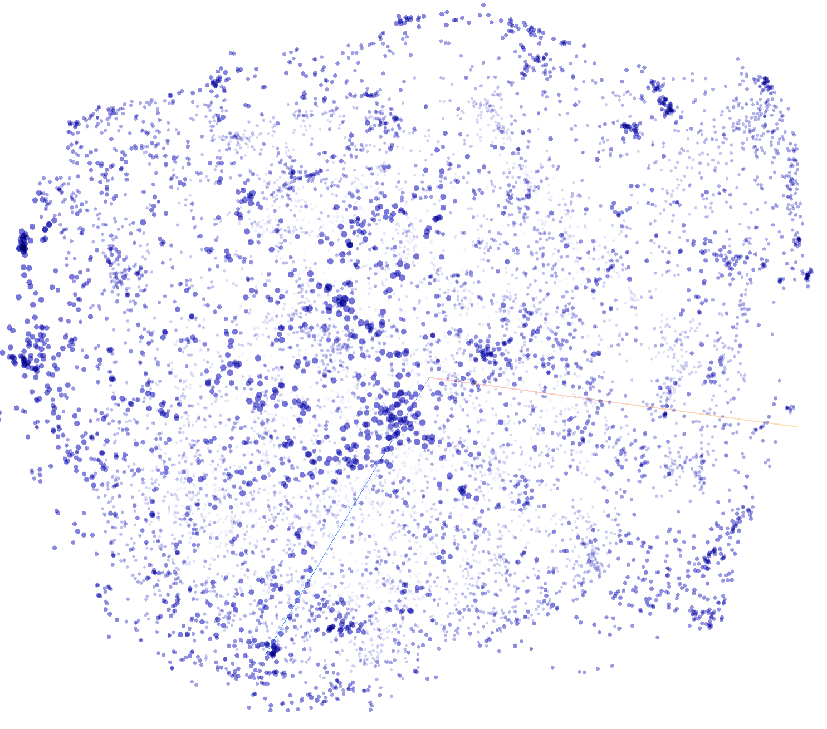


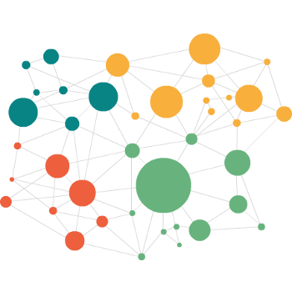

Crossing the AI chasm
Knowledge captured from the mind of the expert
Structured knowledge base
Good for logical deduction and explanation
Deep but rigid and brittle, biased
Human is a bottleneck: hand-engineered features and powerful modeling tools needed
How can we merge human and machine understanding?
Knowledge extracted from data
Broad, flexible, scalable
Good for POS tagging, semantic relatedness, QA, entailment…
Statistic induction, not logical explanation
Lack of true understanding of real-world semantics and pragmatics
Brittle, biased (curated training corpora)
Vecsigrafo
Learning from both large corpora and structured knowledge graphs
Notes:
We have seen limitations on both sides of the spectrum. Statistical ML and purely knowledge-based approaches. We aim at dealing with them through hybrid approaches based on the notion of natural learning, where we try to expand existing knowledge graphs with a representation of the domain knowledge that actually comes from human text, and not o
Denaux, R and Gómez-Pérez, JM (2018). Vecsigrafo: Corpus-based Word-Concept Embeddings - Bridging the Statistic-Symbolic Representational Gap in Natural Language Processing. Semantic Web Journal (under evaluation) http://www.semantic-web-journal.net/content/vecsigrafo-corpus-based-word-concept-embeddings-bridging-statisticsymbolic-representational

Slide 9
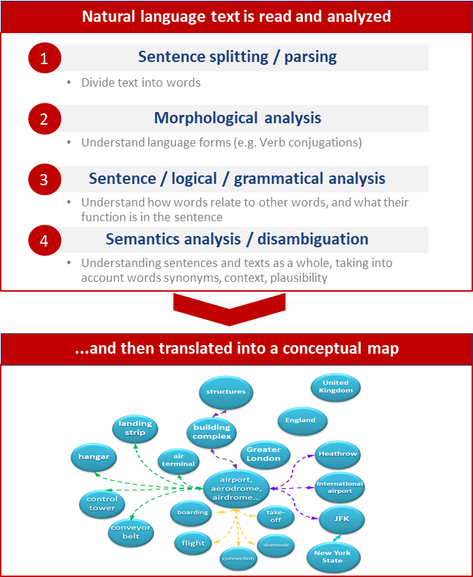
Building blocks: A knowledge-based NLP system
Cogito is a knowledge-based NLP system built on a KG called Sensigrafo, with word definitions, related concepts and linguistic information
At its base, Cogito supports word-sense disambiguation, based on word context over the KG
Main entities include syncons, (concepts), lemmas (canonical representation of a word) and relations (properties, hypernymy, polysemy, synonymy…)
~300K syncons, ~400K lemmas and 80+ relation types (~2.8 million links)
“Prime Minister Boris Johnson is making a last-ditch attempt to persuade MPs to back his Brexit deal as Tuesday's key Commons vote looms closer.”
Word: making
Lemma: make
Concept (meaning): create or produce something
Notes:
In this tutorial, instead of Sensigrafo we are going to use WordNet, which is conceptually similar to Sensigrafo, Expert System’s proprietary knowledge graph

Slide 10

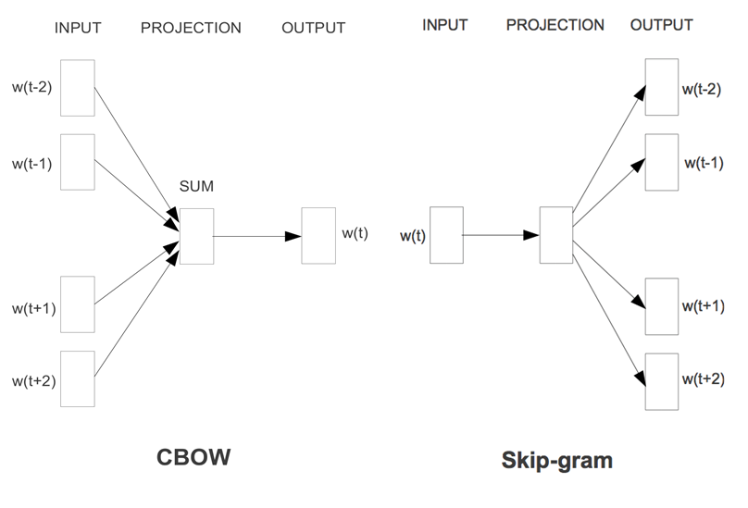
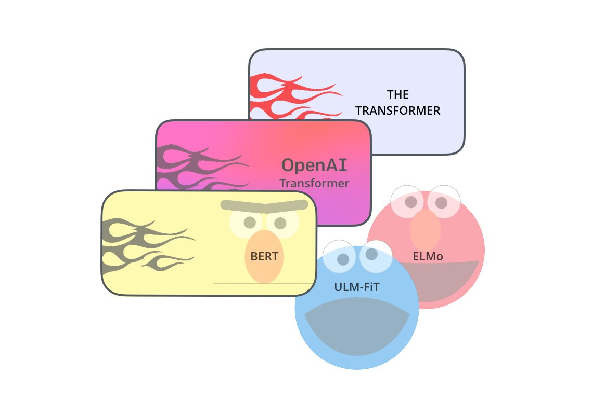
Building blocks: Embeddings & Language Models
Distributed word representations in the form of dense vectors
Capture syntactic and semantic relations between words that can be mapped to vector operations
Successfully applied in NLP, e.g. in part-of-speech tagging, named entity recognition, semantic role labeling and word-sense disambiguation
Variations include [contextualized] word-sense embeddings and knowledge graph embeddings
Notes:
Second piece (building a language model): Embeddings and language models
Not only words!

Slide 11
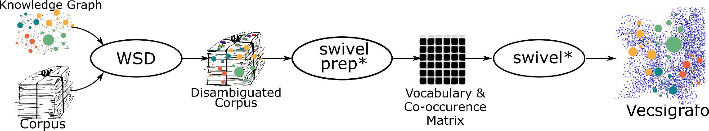

Vecsigrafo
Vecsigrafo jointly learns word and concept embeddings (as opposed to word, sense or knowledge graph embeddings)
Combines corpus-based and graph-based approaches
Extends Swivel algorithm to consider both lexical and semantic entries as part of the vocabulary
The corpus is lemmatized following different tokenization strategies, disambiguated and expanded
Word, lemma and concept embeddings are then jointly learnt
Vecsigrafo: Corpus-based Word-Concept Embeddings

Slide 12
Focus of the tutorial
Methods to extend previously captured knowledge explicitly represented as knowledge graphs with information from text corpora
Main building blocks and techniques enabling such hybrid approach to NLP
How to:
Seamlessly integrate structured and neural representations
Inspect and evaluate the quality of the resulting hybrid representations
Produce higher quality representations, both structured and neural
Improve results in different NLP tasks
Support multi-modality, involving text but also e.g. visual data

Slide 13


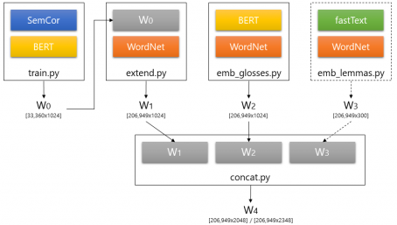
What you will find in this tutorial
What Vecsigrafo (and Transigrafo) is and how to build one

Slide 14
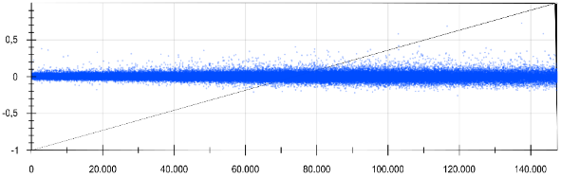
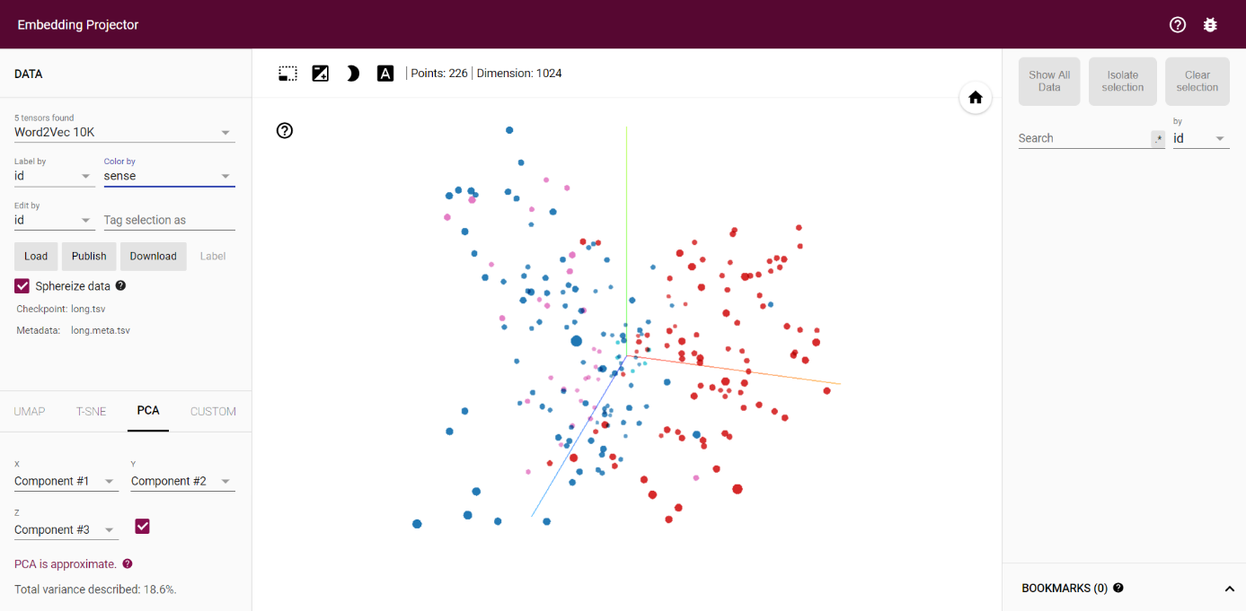
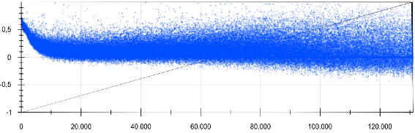
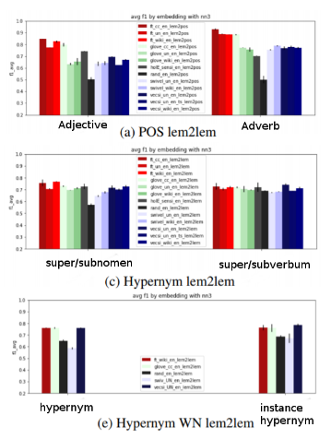
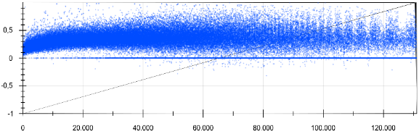
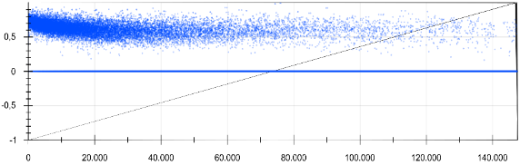
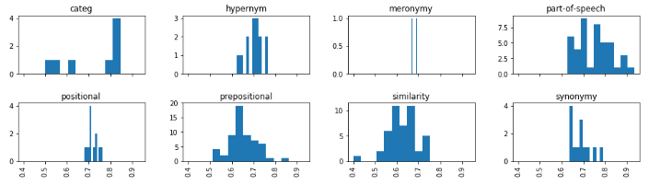
What you will find in this tutorial
How to evaluate the quality of word and concept embeddings beyond word similarity benchmarks
Word Prediction Plots
quality validation and hypothesis checking

Slide 15
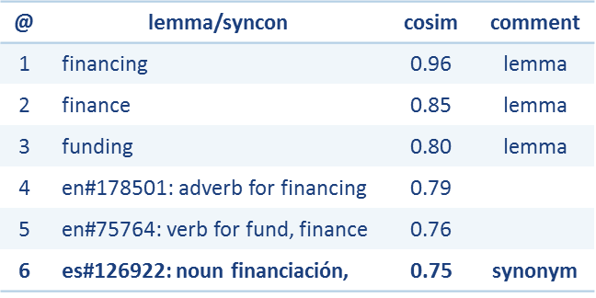

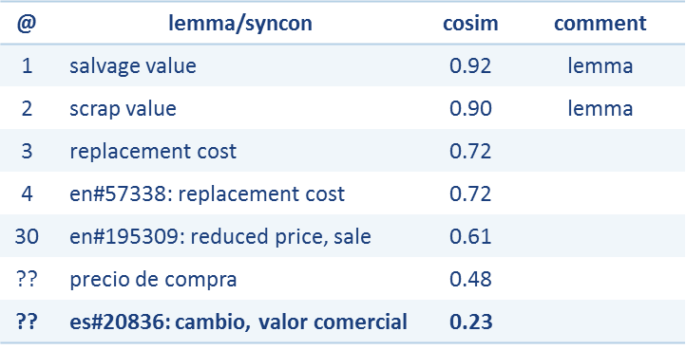

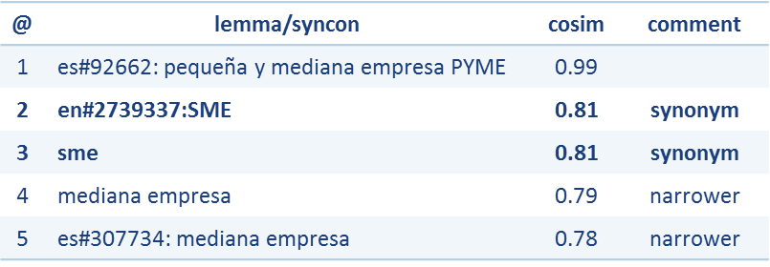
What you will find in this tutorial
“Financing” (EN→ES)
How to leverage hybrid representations to curate and interlink KGs, e.g. in multi-lingual domains
“Scrap value” (EN→ES)
“PYME” (ES→EN)

Slide 16
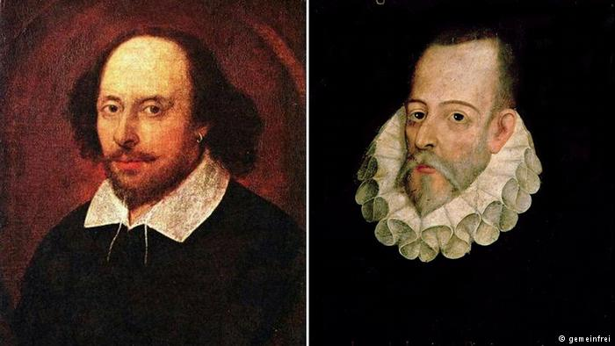

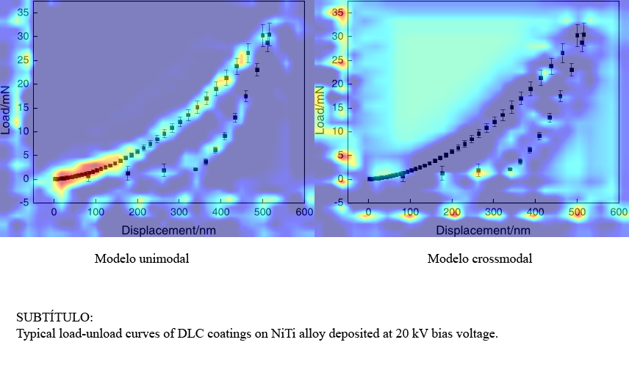
What you will find in this tutorial
Three domains: literature, disinformation and science
Different NLP tasks
Multi-linguality
Multi-modality

Slide 17
Two main blocks - Fundamentals
Lesson 1: Capturing meaning from text as word embeddings
Lesson 1a: Neural language models and contextual embeddings
Lesson 2: Knowledge graph embeddings
Lesson 3: Vecsigrafo – hybrid knowledge representations from text and KGs
Lesson 3a: From Vecsigrafo to Transigrafo - using language models based on transformers
Lesson 4: Evaluating Vecsigrafo – beyond visual inspection and intrinsic methods
Lesson 4a: Evaluating Vecsigrafo (ii) - assessing relational knowledge
Lesson5: Vecsigrafos for knowledge graph curation and interlinking

Slide 18
Two main blocks - Applications
Lesson 6 (exercise): Correlating language in classic literature
Lesson 7: Fake news and deceptive language detection
Lesson 7a: Semantic claim search
Lesson 7b: (Dis)credibility propagation
Lesson 8: Machine reading over multi-modal scientific documents

Slide 19
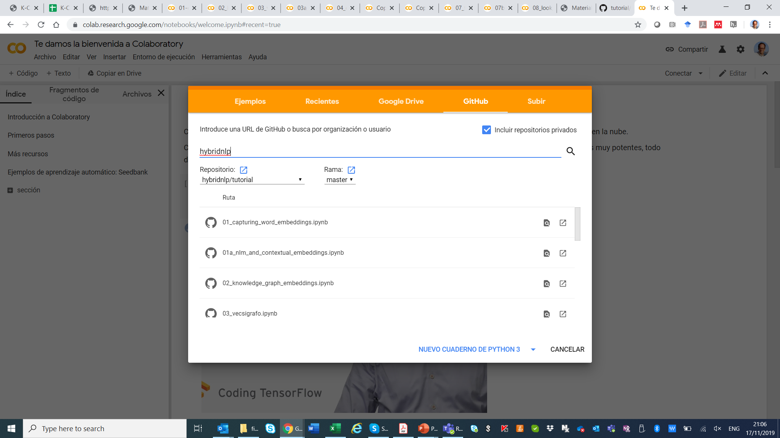
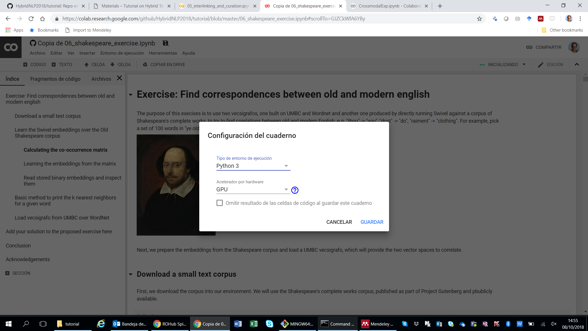
Before we start!
Sign in your Google account and go to “Hello, Colaboratory”: https://colab.research.google.com
Use the GUI to download the tutorial notebooks from the tutorial repo on GitHub: https://github.com/hybridnlp/tutorial
Open the notebook
Select execution environment (Python 3, GPU)
Note that for time constraints, in this tutorial we are using smaller versions of the datasets to train. The complete datasets are available in our repository

Slide 20
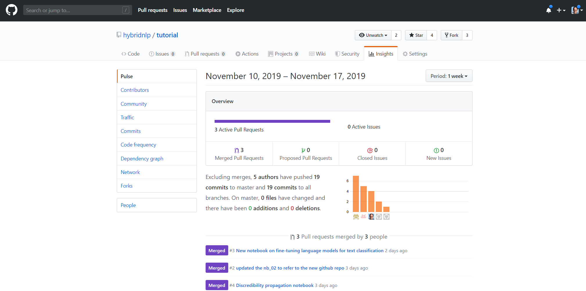
Contributions welcome!
Please submit your pull request!

Slide 21
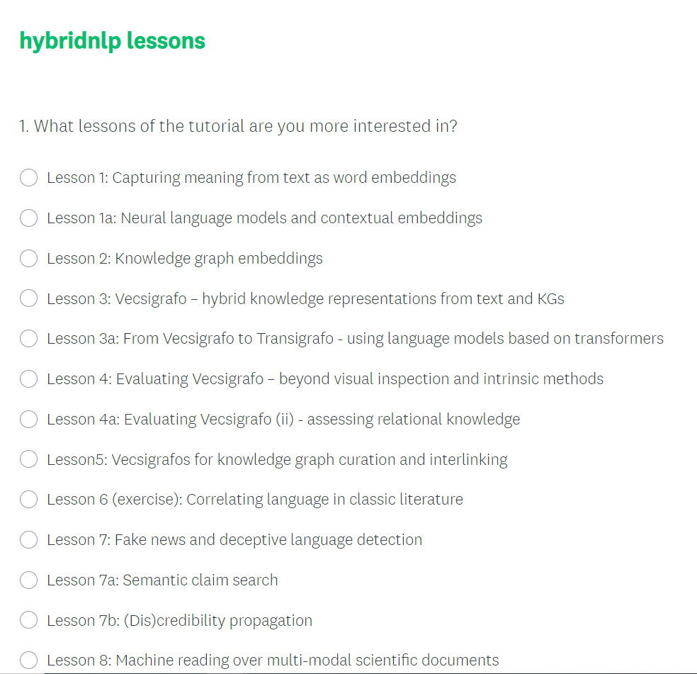

What are you more interested in?
https://es.surveymonkey.com/r/J732KB6

Slide 22
Hybrid Techniques for Knowledge-based NLP knowledge graphs meet machine learning and all their friends
Jose Manuel Gomez-Perez, Ronald Denaux, Raul Ortega {jmgomez,rdenaux,rortega}@expertsystem.com
This tutorial was possible also thanks to the members of the Cogito Lab: Andres García, Cristian Berrío, Flavio Merenda, Pablo Morán
We gratefully acknowledge funding from the Horizon 2020 projects ELG and Co-inform

